Slide 1


Slide 2
A mini project on HEALTH TRACKER
Guidance of:
Mr. Lucknesh Kumar
Submitted By:
Archit Agrawal (1900270130043)
Ayush Khandelwal (1900270130053)

Slide 3
Introduction
The Health Tracker will provide health check using BMI and will also suggest a healthy diet.
Also the Calories intake, recipe of healthy foods to keep yourself fit which is key to live a long life.

Slide 4
Result
As presented before the project was expected to be completed by November end or first week of December.
As expected the Project has been completed successfully within the stipulated time.
The screenshot of the Project are attached in the Presentation.

Slide 5
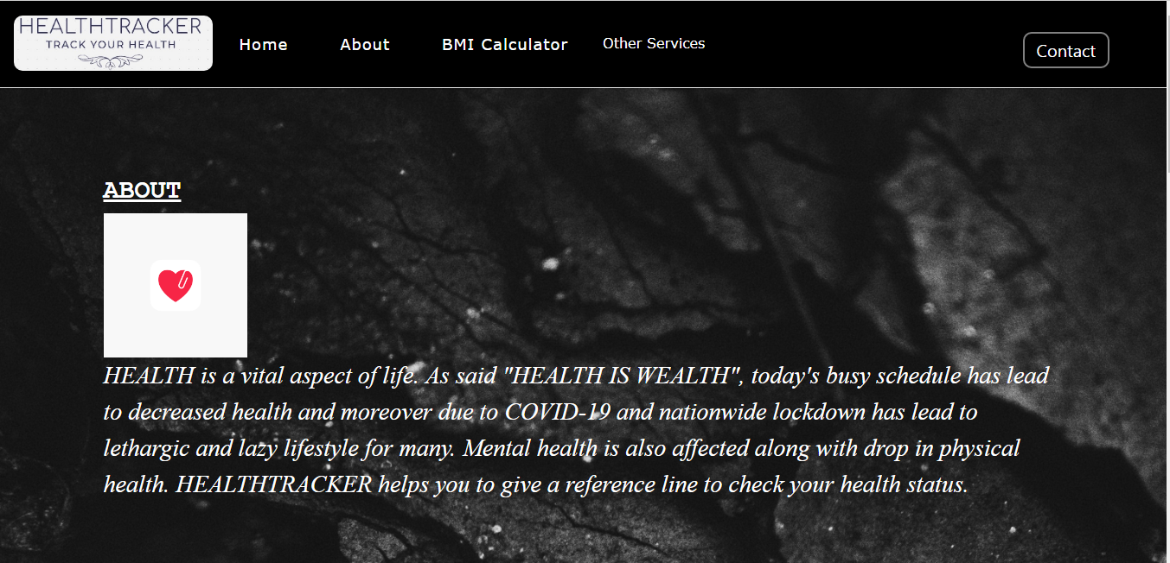
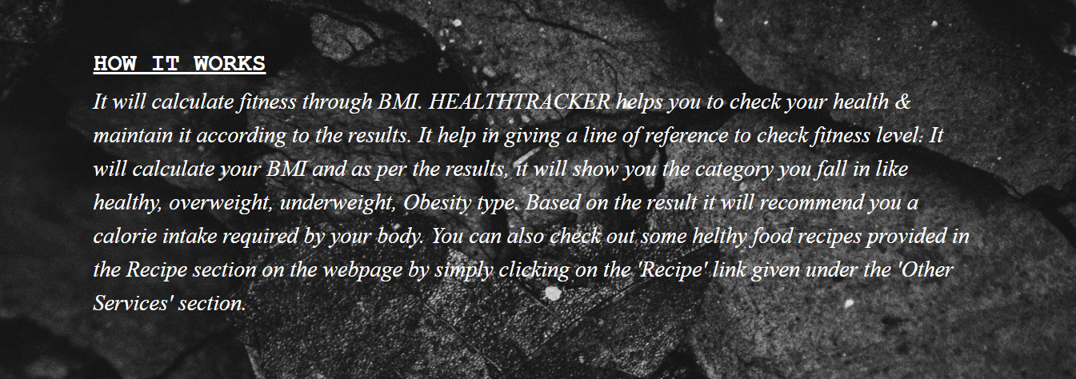
Homepage

Slide 6
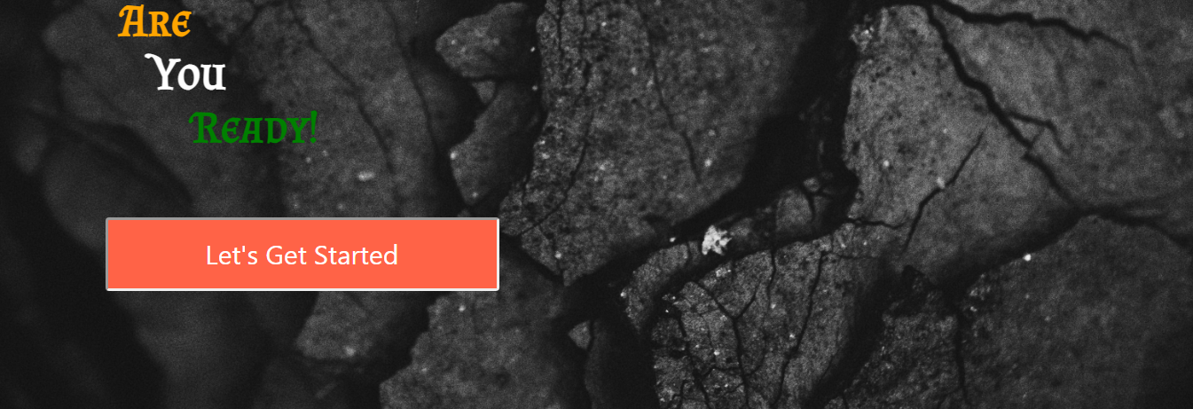
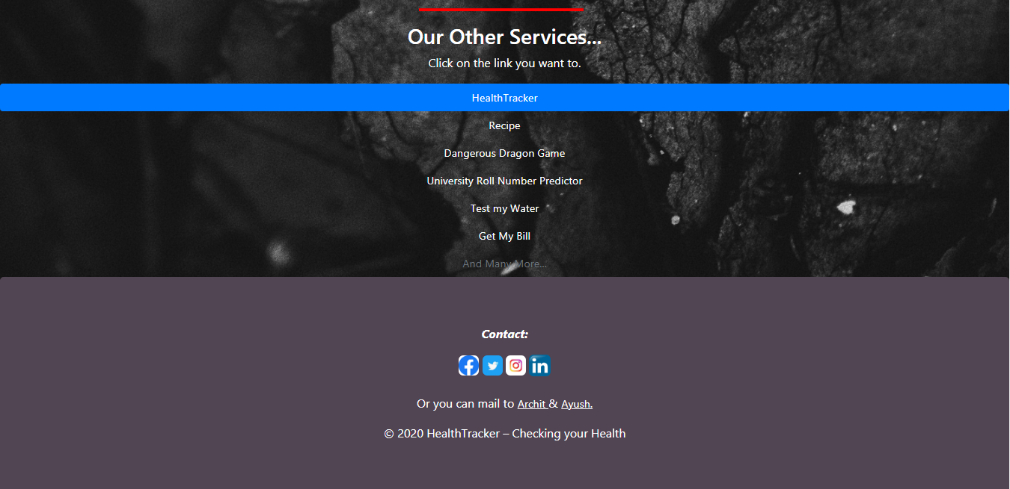

Slide 7
The complete project is made using Bootstrap to make each and every page fit in every size of screen; mobile, tablet, desktop , etc.
On clicking the BMI Calculator link on navigation bar or clicking on the Button given “Let’s Get Started” to redirect yourself to the BMI Calculator page.
You can Contact us by clicking either on the ‘Contact’ button on top right corner or through the links given in the bottom of the homepage.
There are other services provided by us which can be accessed by ‘Other services’ either on top navbar or from ‘Other Services’ section below.

Slide 8
BMI Calculator

Slide 9
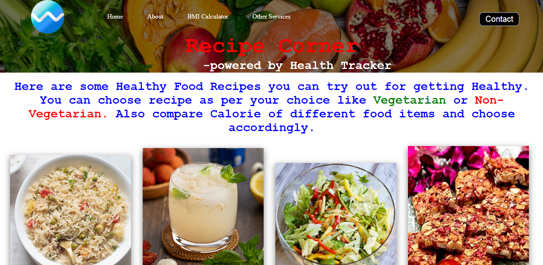
Recipe Page

Slide 10
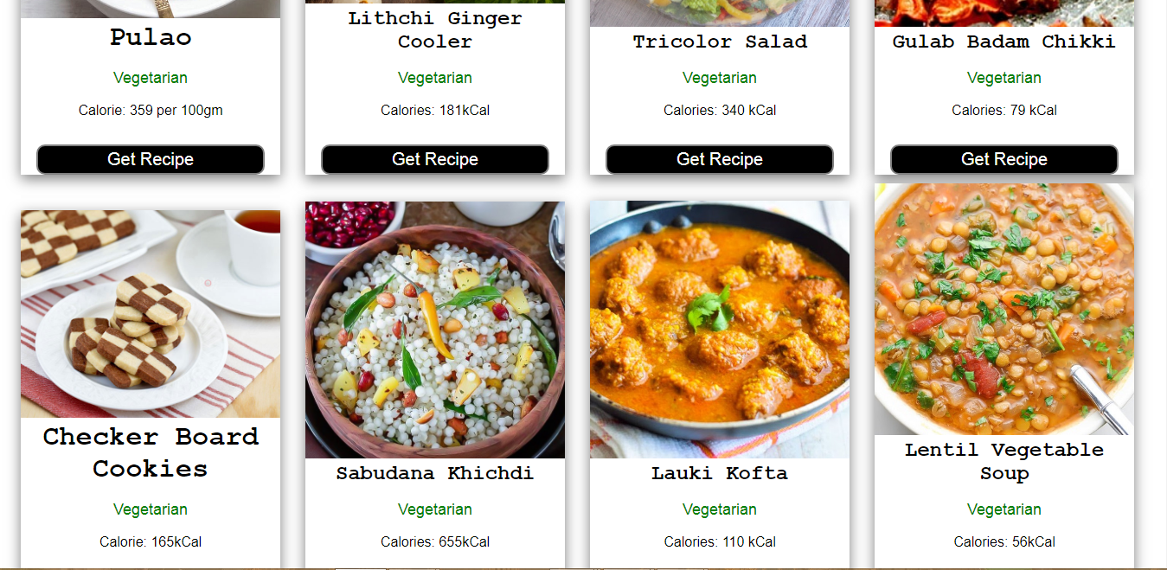
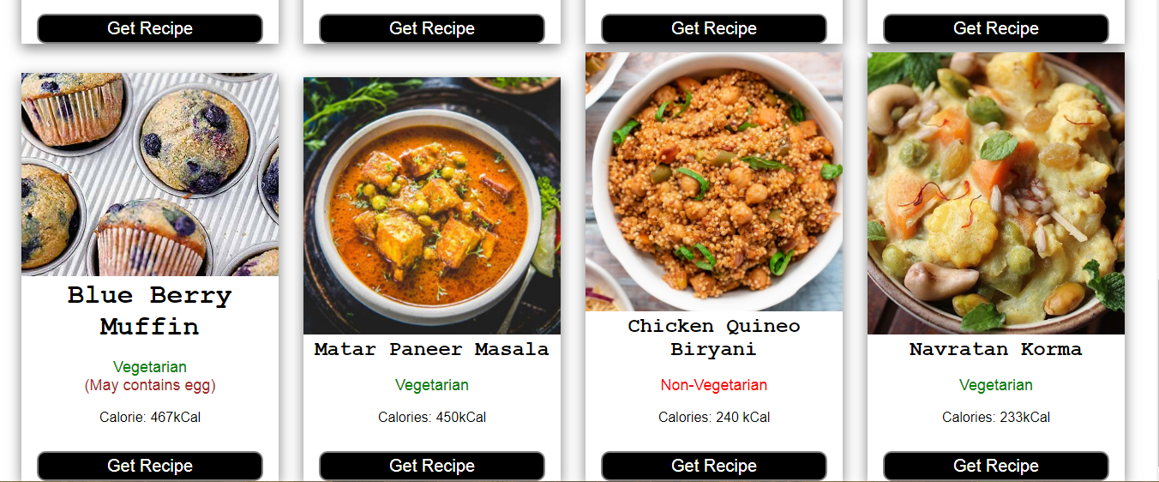

Slide 11
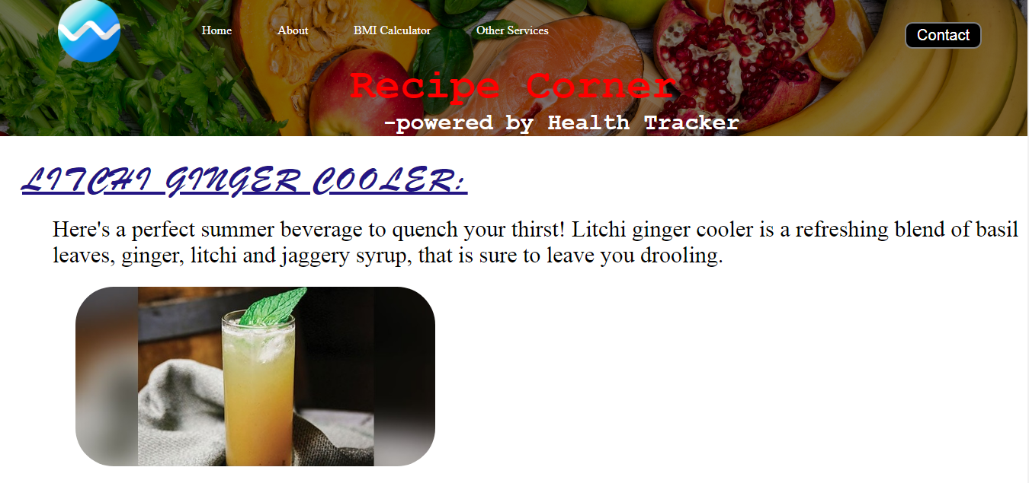
On clicking the ‘Get Recipe’ button on any recipe card , the recipe for the food item will appear. One of the page is given:

Slide 12
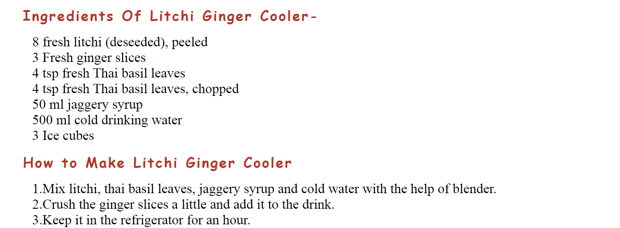
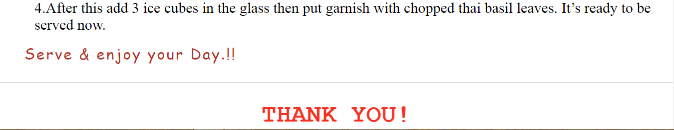

Slide 13
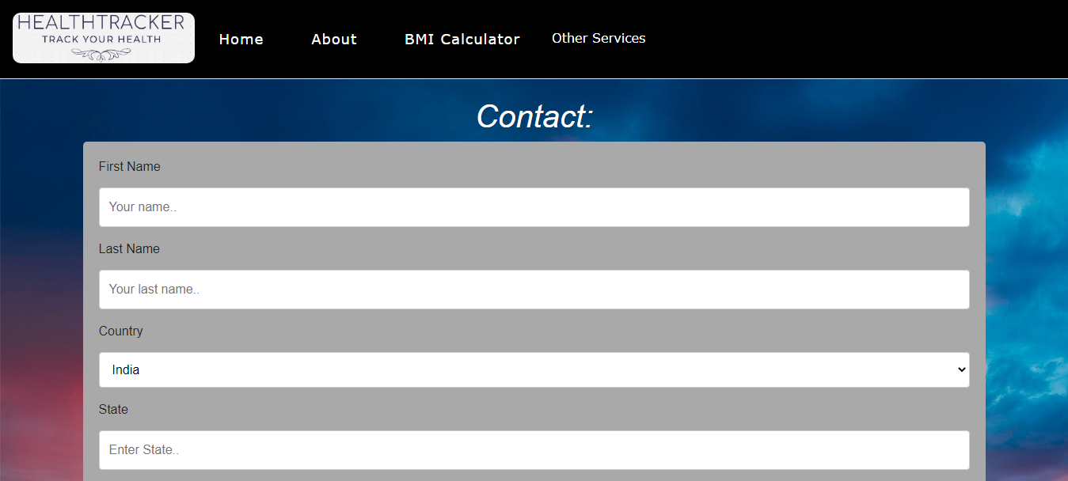
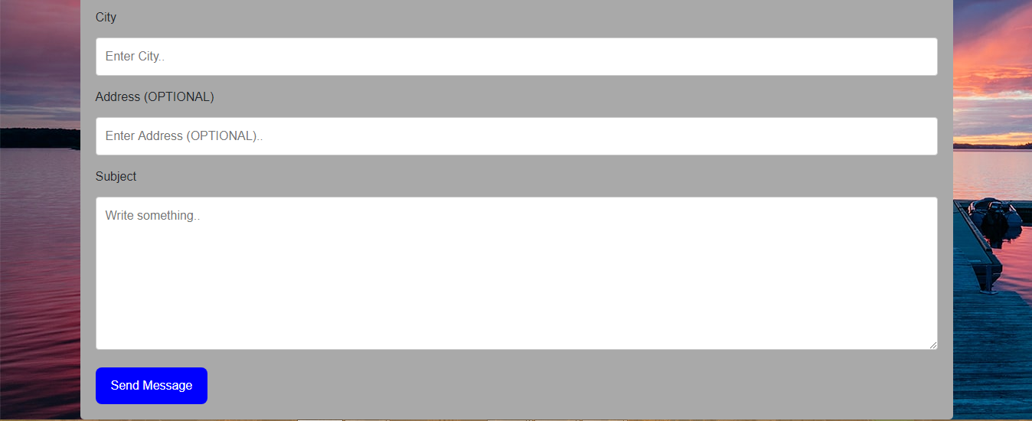
Our ‘Contact’ page

Slide 14
A video of our project. Click on the picture below.

